Slide 1
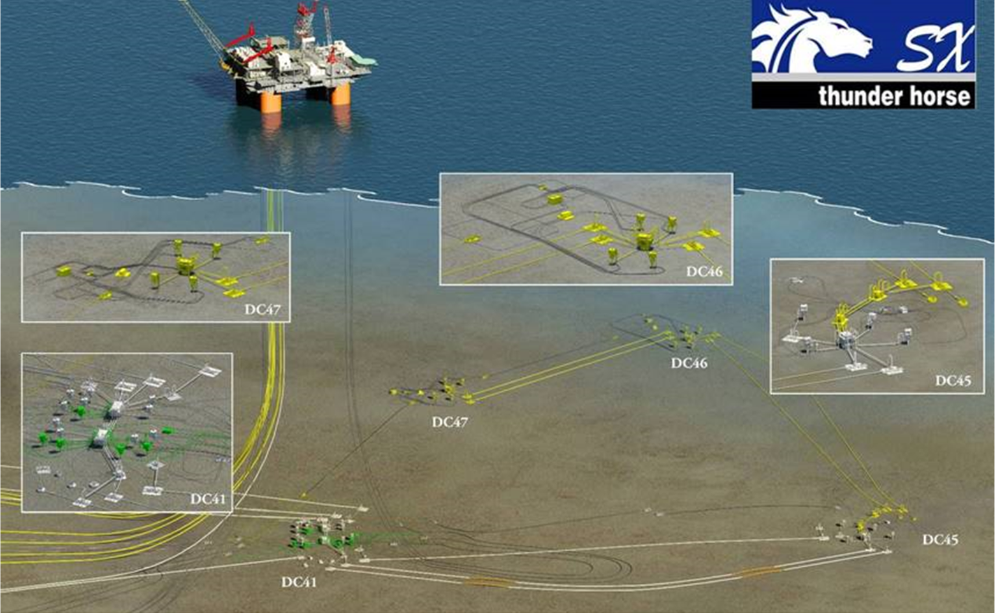
THSX Ph2 Facilities Scope
PDQ Topsides
HPU Expansion
SPCU cabinet
DAS cabinet
4-slot manifold at DC46 and DC47
Static umbilical supplying power/chemicals from DC41
10” dual flowlines tie DC46 and DC47 into DC45

